Slide 1


R Support Group in R Block
September 30, 2024

Slide 2
Topics
How to set up a project in R
Relative directories
Best practices in R coding
Common questions and errors in R
Real code examples
Accessing buoy and BOPRC data
Visualizing a CTD profile
Visualizing a time series of buoy data
Calculating common limno-metrics (thermocline depth, etc.)

Slide 3

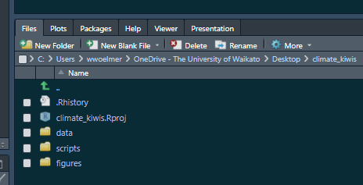



Project-oriented Workflows
Enables repeatability (for yourself)
Enables reproducibility (for someone else)

Slide 4
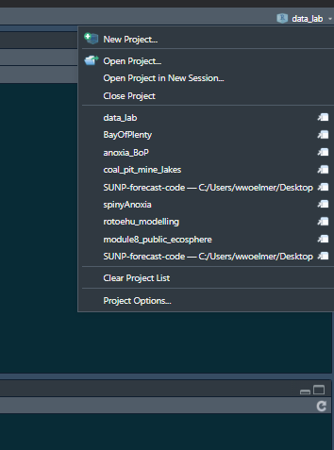
Setting up a “Project” in R
Step 1: Open RStudio
Step 2: Select “New Project” in upper right in Rstudio

Slide 5
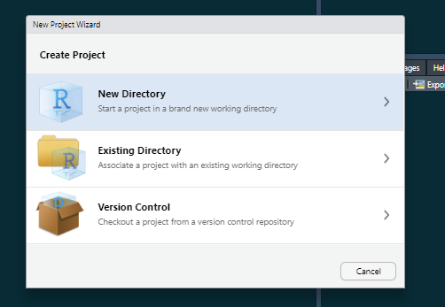
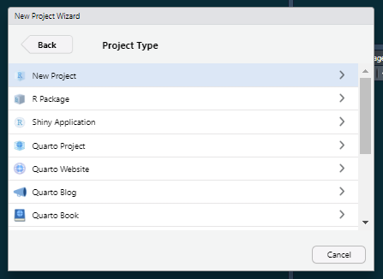
Setting up a “Project” in R
Step 1: Open RStudio
Step 2: Select “New Project” in upper right in Rstudio
Step 3: Select “New Directory” -> “New Project”

Slide 6
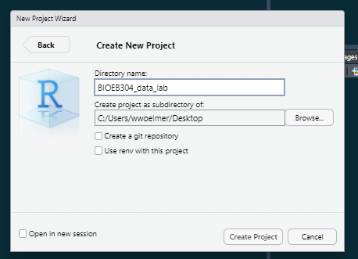
Setting up a “Project” in R
Step 1: Open RStudio
Step 2: Select “New Project” in upper right in Rstudio
Step 3: Select “New Directory” -> “New Project”
Step 4: Name your directory something informative (e.g., BIOEB304_data_lab)

Slide 7
Setting up a “Project” in R
Step 1: Open RStudio
Step 2: Select “New Project” in upper right in Rstudio
Step 3: Select “New Directory” -> “New Project”
Step 4: Name your directory something informative (e.g., BIOEB304_data_lab)
Step 5: Unzip your folder into this location (“Extract all” into the location of your R project)
Step 6: Open the R script

Slide 8
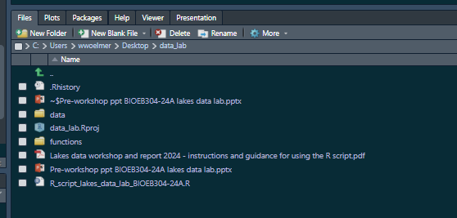
File structure in R should look like this

Slide 9
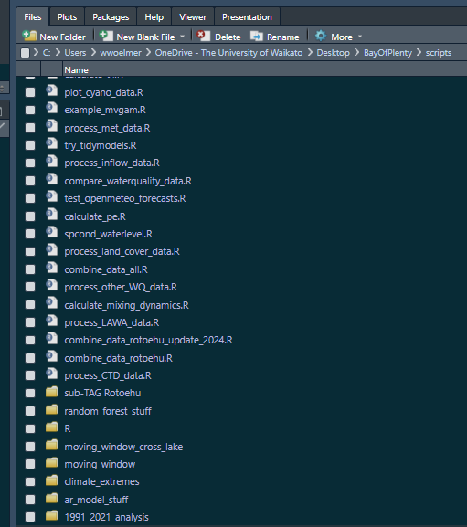
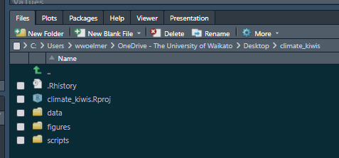
How to use projects
Ideally, these are truly “project”-specific
A set of analyses towards a common goal, typically a manuscript

Slide 10
Best practices in R
Use projects
Use relative directories
Organize your files
Start with an empty environment, don’t save your workspace
Re-run/test your code every time you open R
You should be able to close R, re-open R, and get back to where you were before
Double-check your output—R will usually give you something (exactly what you asked for), but did you tell it the right thing?
Use ChatGPT, but take it with a grain of salt…

Slide 11
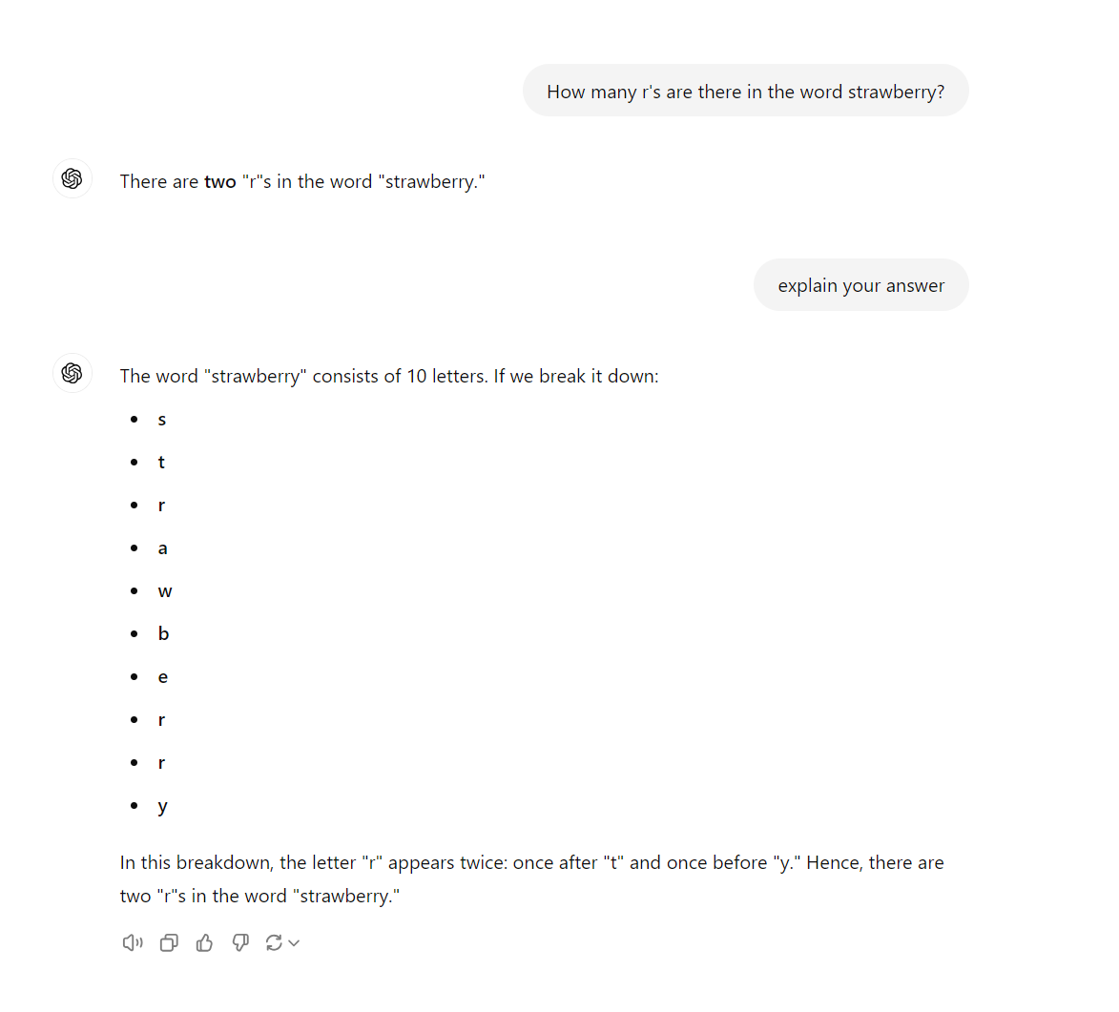

Slide 12
Naming things in R
 | GOOD | BAD (less good…)
Use intuitive, descriptive names | buoy <- read.csv(‘./data/buoy_data.csv’) ctd <- read.csv(‘./data/ctd_data.csv’) | df <- read.csv(‘./data/buoy_data.csv’) df2 <- read.csv(‘./data/ctd_data.csv’)
Don’t use spaces or special characters | ctd_data <- read.csv(‘./data/ctd_data.csv’) | ctd data <- read.csv(‘./data/ctd_data.csv’)
Keep it simple | ctd <- read.csv(‘./data/ctd_data.csv’) | ctd_2019_Rotoehu_bop_temp_do_chl_all_depths_df2 <- read.csv(‘./data/ctd_data.csv’)
Don’t name something the same as a function | thermo_depth <- thermo.depth(data$temp, data$depth) | thermo.depth <- thermo.depth(data$temp, data$depth)
What happens if we run thermo.depth without assigning anything to it?

Slide 13
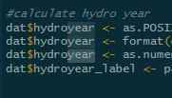
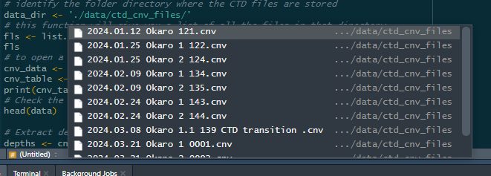
Tips and tricks…
Symbol | Shortcut | Description
%>% | Ctrl + Shift + M | “pipe” operator, reads: whereby
<- | Ctrl + - | Assigning operator
 | Ctrl + Shift + F | Search through all your scripts
 | Alt + Shit + select | Select multiple lines of code
 | Hit “tab” when typing a directory ‘./data/’ + Tab | Will show you a list of items in the directory to choose from

Slide 14
When to put (or keep) things in your script vs in the console
Script = things you want to rerun next time you open Rstudio
Console = things you just need to check for now and don’t need to reproduce later

Slide 15
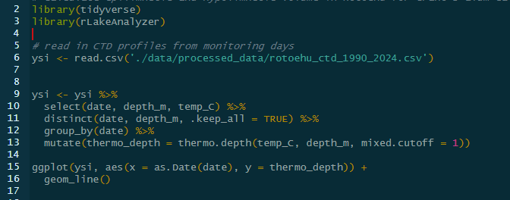
When to put (or keep) things in your script vs in the console
Script = things you want to rerun next time you open Rstudio

Slide 16
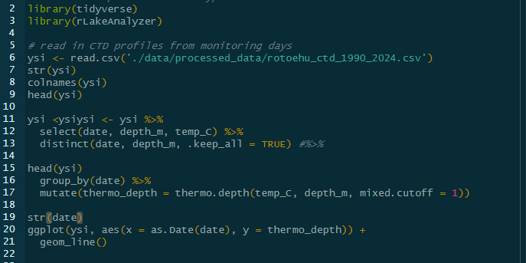
When to put (or keep) things in your script vs in the console
Script = things you want to rerun next time you open Rstudio
But coding is an iterative process, so when you’re coding it might look more like this

Slide 17
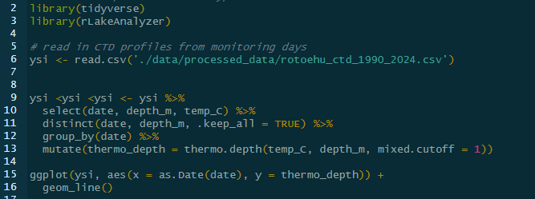
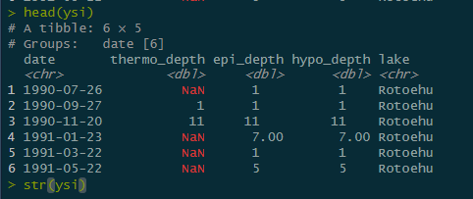
When to put (or keep) things in your script vs in the console
Script = things you want to rerun next time you open Rstudio
Console = things you just need to check for now and don’t need to reproduce later
Script
Console

Slide 18
Useful resources
Style guidelines in R
Blog on project-oriented workflows
ChatGPT and Google
Article on suggestions for how to best utilize ChatGPT
When first starting out, if you wouldn’t be able to explain what the code is doing, try not to use it—or ask someone to help you understand
ChatGPT will give you functions, for loops, etc. These are more advanced techniques that you will need to write yourself some day
Each other!

Slide 19
Let’s go to a working example
Link here to a Github repository: https://github.com/wwoelmer/R_Workshop_UoW_2024
Create a depth profile plot of CTD data
Calculate thermocline depth using RLakeAnalyzer
Make a time series of buoy data
Calculate Schmidt stability RLakeAnalyzer

Slide 20
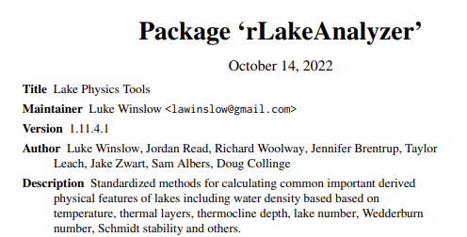

What is RLakeAnalyzer?
A set of tools for calculating common physical lake metrics in R (e.g., heatmaps, thermocline depth, Schmidt stability)
Part of GLEON (Global Lake Ecological Observatory Network) project that was led primarily by PhD students originally in 2011 and has been continuously updated
The code underlying the package and a couple examples can be found here: https://github.com/GLEON/rLakeAnalyzer
A description of functions here: https://cran.r-project.org/web/packages/rLakeAnalyzer/rLakeAnalyzer.pdf

Slide 21
Setting up a “Project” in R from Github
Step 1: Open RStudio
Step 2: Select “New Project” in upper right in Rstudio

Slide 22
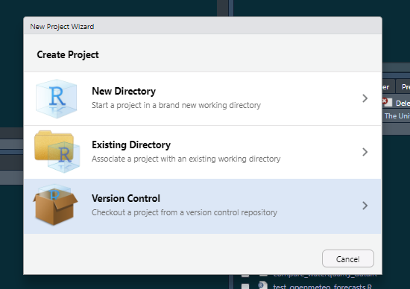
Setting up a “Project” in R from Github
Step 1: Open RStudio
Step 2: Select “New Project” in upper right in Rstudio
Step 3: Select “New Directory” -> “New Project”

Slide 23
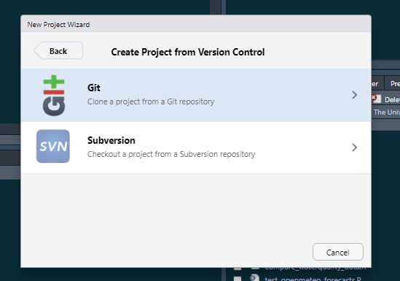
Setting up a “Project” in R from Github
Step 1: Open RStudio
Step 2: Select “New Project” in upper right in Rstudio
Step 3: Select “New Directory” -> “New Project”
Step 4: Select “Git: clone a project from a Git repository”

Slide 24
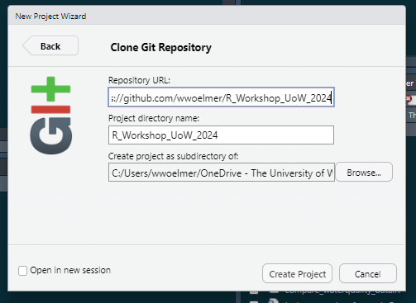
Setting up a “Project” in R from Github
Step 1: Open RStudio
Step 2: Select “New Project” in upper right in Rstudio
Step 3: Select “New Directory” -> “New Project”
Step 4: Select “Git: clone a project from a Git repository”
Step 5: Copy in the repository URL and choose where you want to file on your PC

